Slide 1
TELECOM CUSTOMER CHURN PREDICTION PROJECT
BY: Anthony Maina Njeru

Slide 2
INTRODUCTION
TelecomCorp is experiencing significant customer attrition, losing valuable revenue. The need for a predictive model is urgent to identify at-risk customers before they leave.

Slide 3
Business Problem
TelecomCorp is losing customers due to a 14.5% annual churn rate, and they have no systematic way to identify which customers are about to leave before it happens.

Slide 4
Objectives
Build a baseline logistic regression model
Optimize the model through hyperparameter tuning
Compare using classification metrics (Precision, Recall, F1)
Identify model providing best business value
Provide implementation recommendations

Slide 5
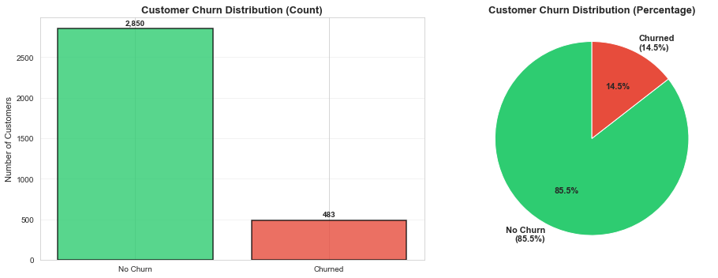
Findings through visuals
Here we get to see the Imbalance between churn and No churn.

Slide 6
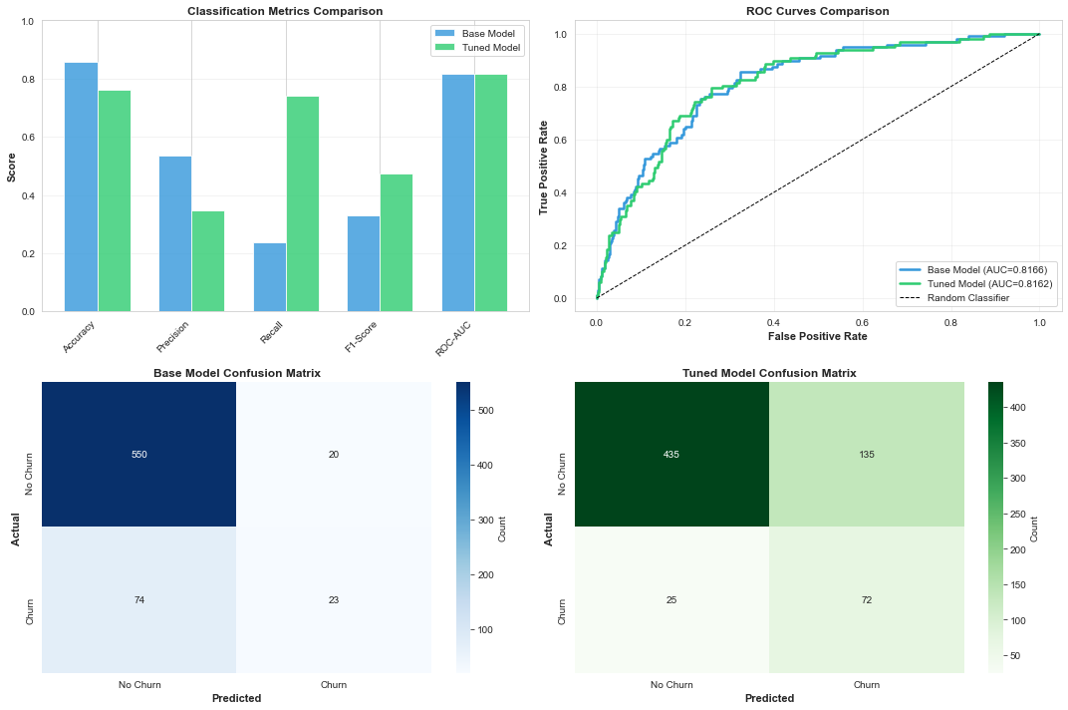
Second Visual: Model Comparison
In this visual we get to see the tuned model outperforms the base model across most evaluation metrics (Accuracy, Precision, Recall, F1-Score, and ROC-AUC).
Improvements indicate better overall predictive performance and more balanced classification.

Slide 7
ROC Curve Insights
The tuned model’s ROC curve is closer to the top-left corner, showing stronger discrimination ability.
Higher AUC score confirms the tuned model is better at distinguishing between churn and non-churn customers.
Both models perform better than a random classifier, but the tuned model is clearly superior.

Slide 8
Confusion Matrix Analysis
Base Model:
Higher number of misclassifications (false positives and false negatives).
Less reliable in identifying churn cases.
Tuned Model:
Reduced misclassification errors.
Improved detection of actual churn cases (better recall).
More accurate overall predictions.

Slide 9
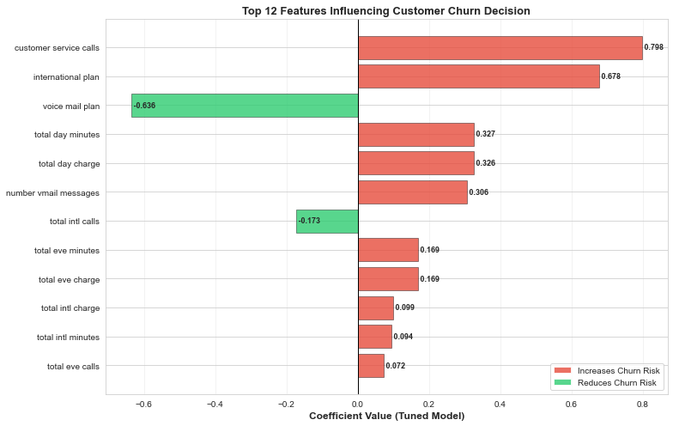
Last Visual: Feature Importance
The chart highlights the top 12 features influencing churn decisions in the tuned model.
Red bars (positive coefficients) - Increase likelihood of churn
Green bars (negative coefficients) - Reduce likelihood of churn

Slide 10
Explanation:
Top Increasing Churn Risk
Frequent customer service calls - Strong indicator of dissatisfaction
Lack of international plan - Customers more likely to leave
High daytime usage - Possible service quality or pricing concerns
Factors Improving Customer Retention
Voice mail plan subscription - Strongly linked to customer loyalty
Higher international call activity - Engaged, retained customers

Slide 11
Recommendations
Deploy Tuned Model to score all customers monthly
Create Risk Segments based on churn probability
Launch Retention Campaigns targeting top 100-150 at-risk customers

Slide 12
Conclusion
PRODUCTION-READY:
The tuned model successfully handles the 85:15 class imbalance and delivers actionable insights. By focusing on recall (catching churners) over accuracy, I've built a system aligned with business objectives and ready to drive measurable retention improvements.

